Slide 1
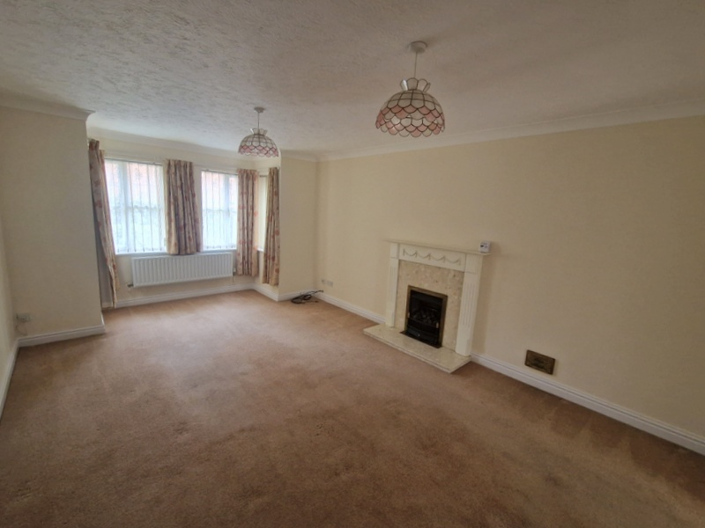
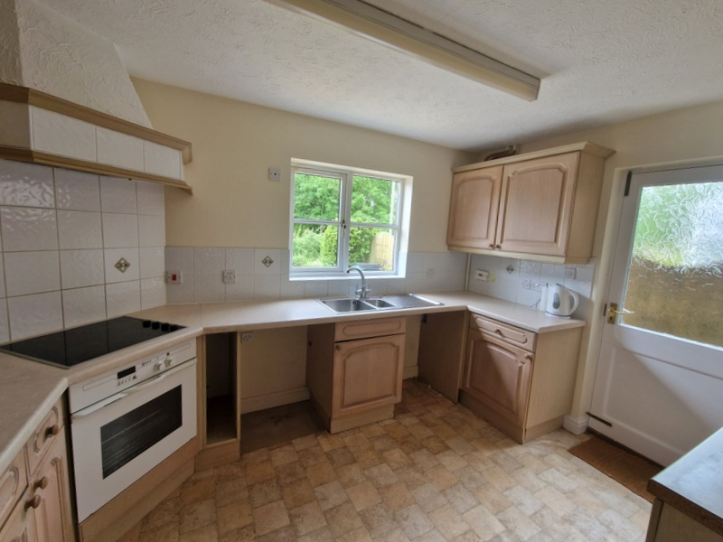
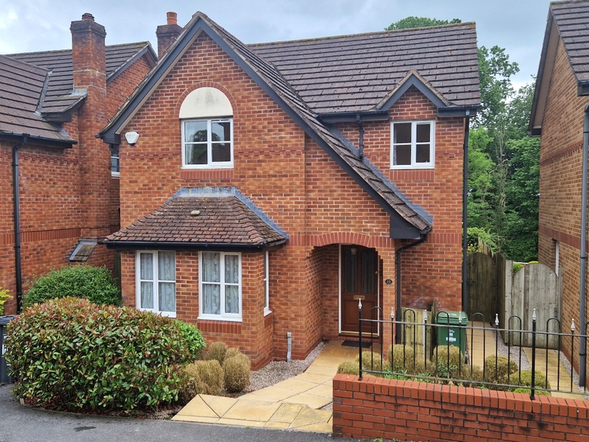
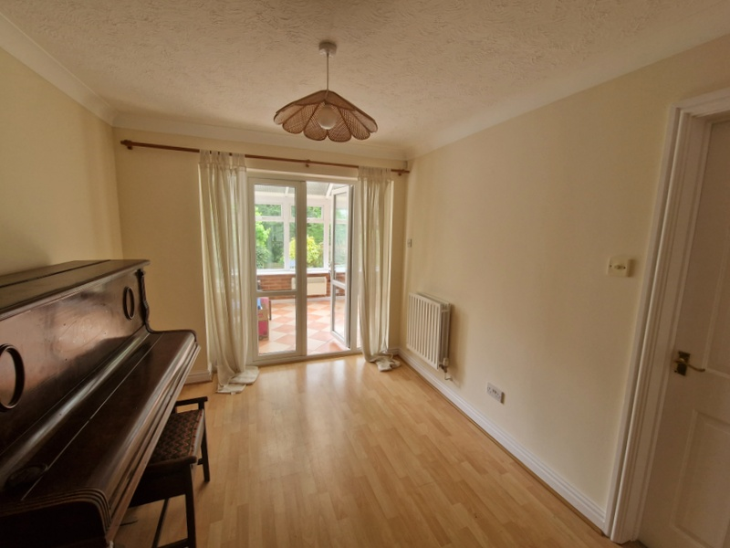
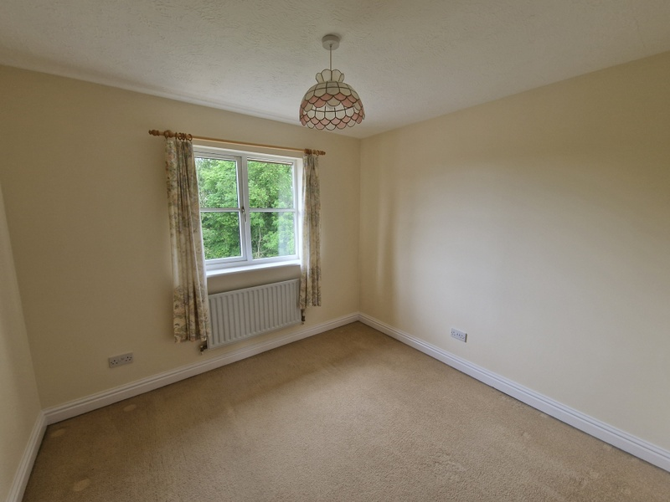
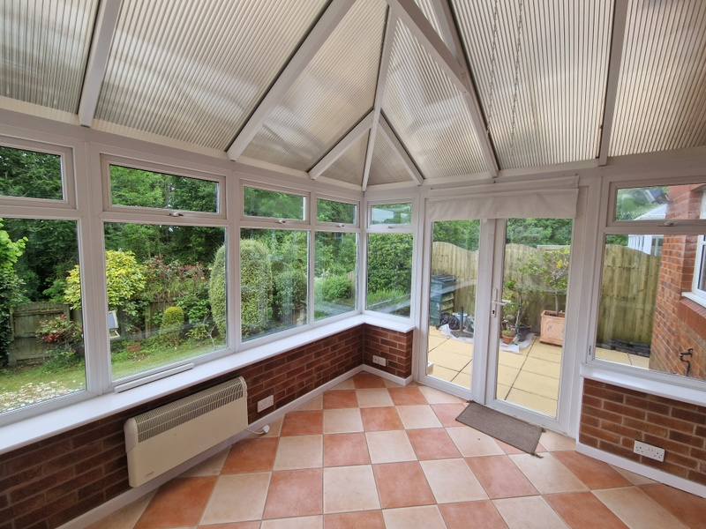
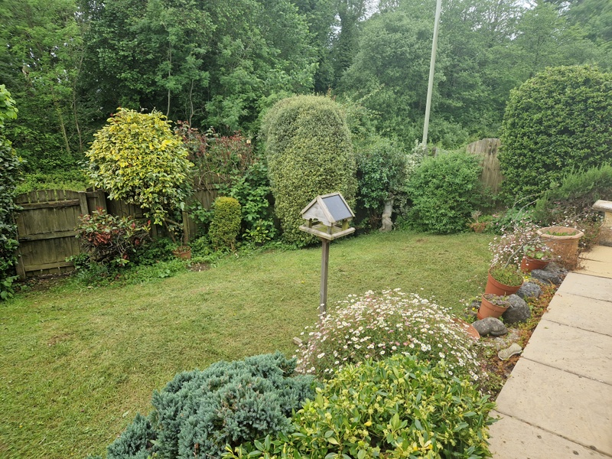
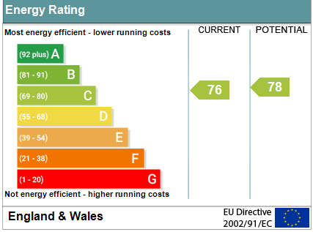
www.pennys.net
10 Port Mer Close, Exmouth, EX8 5RF
GUIDE PRICE £435,000
TENURE Freehold
An Attractively Designed Detached House Located In A Favoured Development Offered For Sale With No Ongoing Chain
Newly Decorated Accommodation * Reception Hall * Ground Floor Cloakroom/Wc * Lounge * Dining Room * Conservatory * Kitchen * Four First Floor Bedrooms * En-Suite Shower Room/Wc * Family Bathroom/Wc Southerly Aspect Rear Garden * Single Garage * Gas Central Heating Via Modern Boiler * Double Glazed Windows * Off Street Parking Solar Panels * Superb Family Home
Pennys Estate Agents Limited for themselves and for the vendor of this property whose agents they are give notice that:- (1) These particulars do not constitute any part of an offer or a contract. (2) All statements contained in these particulars are made without responsibility on the part of Pennys Estate Agents Limited. (3) None of the statements contained in these particulars are to be relied upon as a statement or representation of fact. (4) Any intending purchaser must satisfy himself/herself by inspection or otherwise as to the correctness of each of the statements contained in these particulars. (5) The vendor does not make or give and neither do Pennys Estate Agents Limited nor any person in their employment has any authority to make or give any representation or warranty whatever in relation to this property.
PENNYS ESTATE AGENTS
2 Rolle House, Rolle Street, Exmouth, Devon, EX8 2SN
Tel: 01395 264111 EMail: help@pennys.net

Slide 2
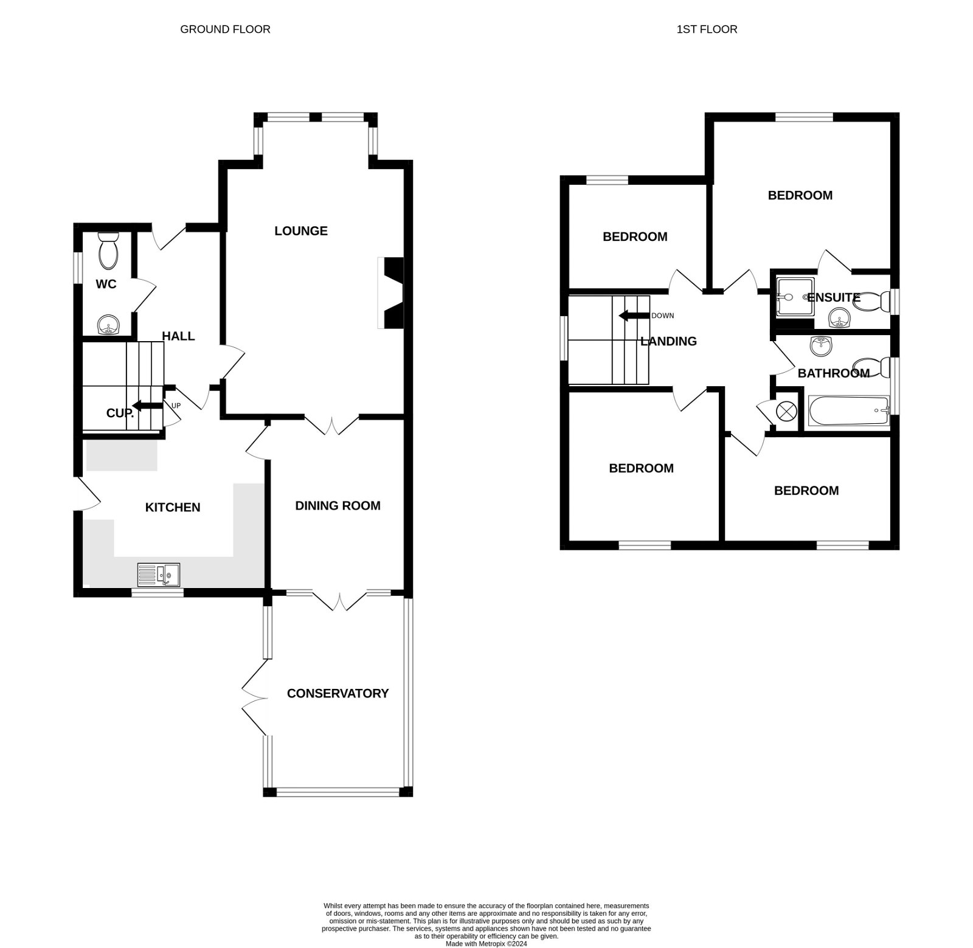
10 Port Mer Close, Exmouth, EX8 5RF
THE ACCOMMODATION COMPRISES: Entrance porch with courtesy light, front door with patterned glass inset giving access to:
RECEPTION HALL: Radiator, turning staircase rising to first floor landing with feature arched double glazed window on half landing.
GROUND FLOOR CLOAKROOM/WC: Pedestal wash hand basin with tiled splashback, WC, radiator, electric consumer unit, double glazed window with patterned glass.
LOUNGE: 5.79m x 3.56m (19'0" x 11'8") measurement to double glazed square bay window which overlooks the front aspect, living flame effect coal gas fire (untested) in fire surround with marble hearth with matching inset. TV point, telephone point, two radiators, glazed panelled double doors to:
DINING ROOM: 3.35m x 2.72m (11'0" x 8'11") (also access from the kitchen) With wood effect flooring, radiator, double glazed double doors with picture windows to either side giving access to:
CONSERVATORY: 4.09m x 2.74m (13'5" x 9'0") A fine addition to the accommodation with double glazed windows overlooking the rear garden, with double glazed double doors opening onto patio sun terrace. Power and light connected, TV point, tiled flooring.
KITCHEN: 3.76m x 3.63m (12'4" x 11'11") maximum overall measurement. Access from the reception hall and the dining room. Fitted range of worktops with cupboards, drawer units, plumbing for automatic washing machine and further appliance spaces beneath worktops. With tiled surrounds, wall mounted cupboards – one housing Baxi gas boiler for hot water and central heating. One and quarter bowl single drainer sink unit set into surface with mixer tap, inset four ring ceramic electric hob with built-in oven below and extractor hood over. Access to good size understair storage cupboard. Double glazed window to rear aspect and part glazed door with patterned glass to outside. Radiator.
FIRST FLOOR LANDING: With access to roof space, recessed ceiling spotlighting, radiator, airing cupboard with water cylinder and slatted shelving.
BEDROOM 1: 3.58m x 3.58m (11'9" x 11'9") With double glazed window to front aspect, radiator, TV point.
EN-SUITE SHOWER ROOM/WC: Fitted with tiled shower cubicle with splash screen door, pedestal wash hand basin, WC, part tiled walls, fitted mirror with light shaver socket over, radiator, ceiling extractor fan, double glazed window with patterned glass.
BEDROOM 2: 9’10 x 9’5 Double glazed window to rear aspect, radiator.
BEDROOM 3: 3.4m x 2.13m (11'2" x 7'0") With double glaze window to rear aspect, radiator.
BEDROOM 4: 2.84m x 2.06m (9'4" x 6'9") With double glazed window to front aspect, radiator, telephone point, TV point.
FAMILY BATHROOM/WC: 2.39m x 1.98m (7'10" x 6'6") max overall measurement. Bath with shower attachment, pedestal wash hand basin, WC, extensively tiled walls, mirror fronted medicine cabinet, light shaver socket, extractor fan, radiator, double glazed window with patterned glass.
OUTSIDE: The property is approached by a tarmac driveway to off street parking and a single garage. To the front of the property is an attractive garden with colourful shrubs, patio steps giving access to the property. Patio side pathway with gate giving access through to the rear garden which enjoys a sunny Southerly aspect comprising a patio sun terrace, lawned garden edged with mature flower and shrub beds. There is an outside cold water tap and timber garden store and outside lighting. There are solar panels fitted to the rear of the property.
GARAGE: With up and over door, power and light connected.
FLOOR PLAN:

